Slide 1



Slide 2

YAMAHA MOTORCYCLES SALES ANALYSIS & CUSTOMER INSIGHTS
SUBMITTED BY:
SUBMITTED TO:
. MARUF HASAN SHUVO
. Md Mahbub E Noor
. Dept. of Computer
Science & Engineering
. Lecturer
Dept. of Computer
Science & Engineering
. Roll:250 10 20 22
[CSE-1102]

Slide 3


INTRODUCTION
In today’s modern business environment, data analysis plays a crucial role in making effective and informed decisions. Companies rely on data to understand their performance, customer behavior, and market trends.
This project is all about looking at how well Yamaha motorcycles are selling and what customers think of them, using a tool called Microsoft Excel. Yamaha is a really popular brand when it comes to motorcycles, especially among younger riders, because of how well they perform and how they look.
The purpose of this project is to analyze sales data and identify customer preferences through a structured dataset. By using advanced Excel tools, two interactive dashboards were created to visualize business performance and customer behavior.
This project highlights how data visualization techniques can transform raw data into meaningful insights and support better decision-making in real-world business scenarios.

Slide 4
OBJECTIVES
The primary objectives of this project focus on analyzing Yamaha motorcycle sales data and understanding customer behavior through Microsoft Excel dashboards.
The first objective is to evaluate overall sales performance by examining total sales, revenue, costs, and profits, using Dashboard 1.
The second objective is to assess the performance of various motorcycle models and analyze sales distribution across different divisions.
Another important objective is to gain insights into customer demographics, including age group, occupation, color preference, purchase purpose, and customer satisfaction, utilizing Dashboard 2.

Slide 5
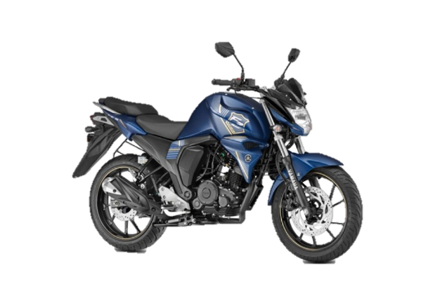
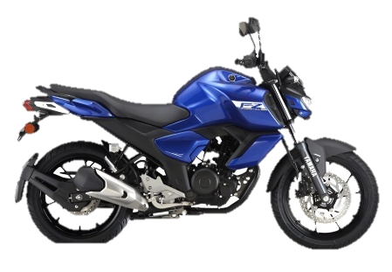
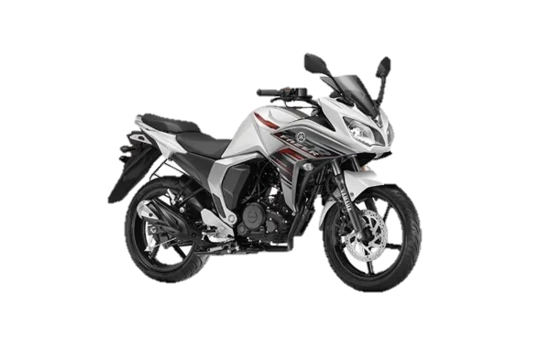
MOTORCYCLE MODELS OVERVIEW
YAMAHA FZ-s V2 : The Yamaha FZS V2, also known as the FZ-S FI Version 2.0, is a 149cc, fuel-injected street-naked motorcycle recognized for its strong design, smooth engine, and balanced handling. This model is a major update to the original FZ16, focusing on fuel efficiency through Blue Core Technology rather than sheer power. This makes it a favorite commuter bike in its class.
YAMAHA FZ-s V3 : The Yamaha FZS-FI V3 is a 149cc, fuel-injected streetfighter designed for comfortable commuting. It has a 4-stroke, SOHC, 2-valve "Blue Core" engine that produces about 12.4 to 13 PS and 12.8 to 13.3 Nm of torque. The bike includes front single-channel ABS, LED headlights, a negative LCD console, and a strong design with an upright, comfortable riding position.
YAMAHA FAZER 25 : The Yamaha Fazer is a great bike for long trips, with a comfortable riding position and a unique half-fairing design. It's often seen as a good alternative to the FZ series, but with a more touring-friendly style. The 150cc Fazer FI V2, which is popular in South Asia, has a 149cc engine with fuel injection, gets around 40-45 km per liter, and weighs about 137 kg when full of fuel. This bike is known for being versatile, coming in a range of sizes from 150cc to 600cc, making it a good choice for different types of riders.

Slide 6

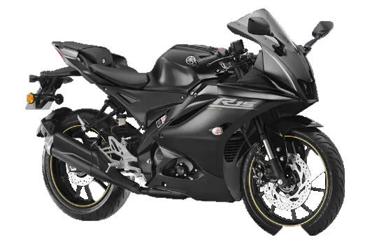
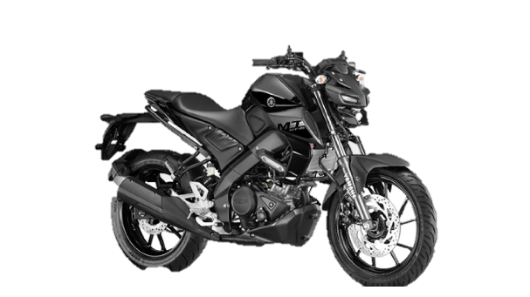
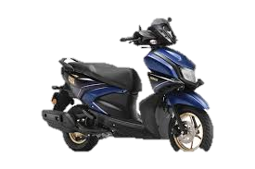
MOTORCYCLE MODELS OVERVIEW
YAMAHA R15 : The 2026 Yamaha R15 (Version 4/M) is a premium 155cc, fully-faired sportbike offering super sports styling, featuring a 18.4 PS liquid-cooled engine, VVA technology, and advanced features like quick shifter, traction control, and USD forks. Known for its sharp handling and racing DNA, it delivers ~40-45 kmpl, making it a popular track-focused commuter.
YAMAHA MT 15 : The Yamaha MT-15 (Version 2.0/V2) is an aggressive 155cc "hyper naked" streetfighter, known for its agile handling and high-performance, R15-derived engine. It features USD front forks, VVA technology, a 6-speed gearbox with a slipper clutch, and Bluetooth connectivity, making it a popular choice for urban commuting and spirited riding.
YAMAHA RAY-zr : The Yamaha Ray ZR 125 Fi Hybrid is a great scooter for city riding, it's really light at just 99 kg and has a powerful 125cc Blue Core engine. What makes it special is the smart motor generator, or SMG, which gives you a boost when you need it, so you can accelerate faster. Plus, it's really good on fuel, with some people getting up to 71 km per liter, which is amazing for a scooter. And when you're out and about, you've got plenty of space to store your stuff, with a big 21-liter compartment under the seat.

Slide 7
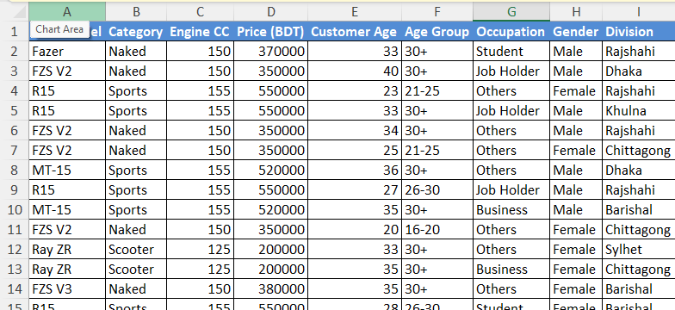
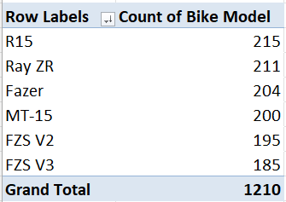
METHODOLOGY
DATA Collections : The methodology of this project was carried out in several structured steps using Microsoft Excel . At first, a dataset was prepared containing more than 1200 records, including information such as bike model, price, division, date, payment type, age group, occupation, color, purchase purpose, and customer rating.
DATA Cleaning : Before analysis, the dataset was carefully cleaned and prepared. Missing or inconsistent values were checked and corrected to ensure data accuracy. Data types such as numbers, text, and dates were properly formatted . The data was organized into an Excel Table, making it easier to work with and analyze. This format allows for dynamic handling of the data, and it's simpler to apply formulas, filters, and pivot tables.
Analytical Tools and Techniques :Microsoft Excel was used as the main analytical tool in this project. Pivot Tables were created to summarize large amounts of data into meaningful insights. These pivot tables helped analyze sales by model, division, age group, and other categories. Pivot Charts were used to visually represent the summarized data, making it easier to understand patterns and trends. Various calculations such as total sales, revenue, cost, and profit were performed using Excel formulas.
Visualization : In this project, data visualization was really important. We used a lot of different charts like bar charts, column charts, pie charts, and donut charts to make the data easy to understand and look nice. This helped us show the information in a way that was clear and simple to see. By using these different types of charts, we could make the data more interesting and easier to grasp, which was a big part of making the project successful.

Slide 8
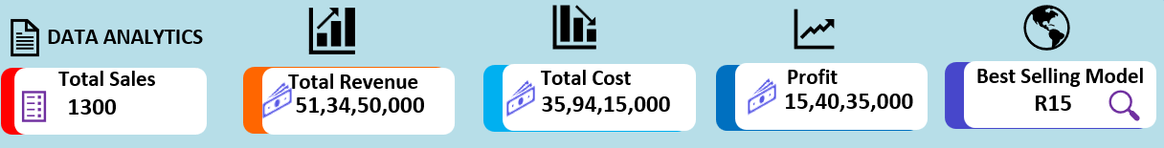
DATA ANALYSIS & FINDINGS
Sales & Business overview (dashboard 1)
KPI Overview: The business performance can be seen at a glance in the KPI section. This is where you find the main points that show how well the business is doing, like how much is being sold, how much money is coming in, what the total costs are, and what the profit is. These numbers help figure out if the business is running smoothly or not.
Model Wise Sales Analysis: This analysis shows the sales distribution among different motorcycle models. It helps identify which models are most preferred by customers. The data indicates that sports and commuter bikes such as Yamaha R15, FZS series, and MT-15 have higher demand compared to other models. This suggests that customers prefer stylish and performance-oriented bikes.
Division Wise Sales Analysis : This section analyzes sales performance across different geographical regions. It helps to identify high-performing and low-performing divisions. It turns out that cities tend to have more bike sales than rural areas, and this is because people in cities generally have more money to spend and are looking for higher-end bikes.

Slide 9
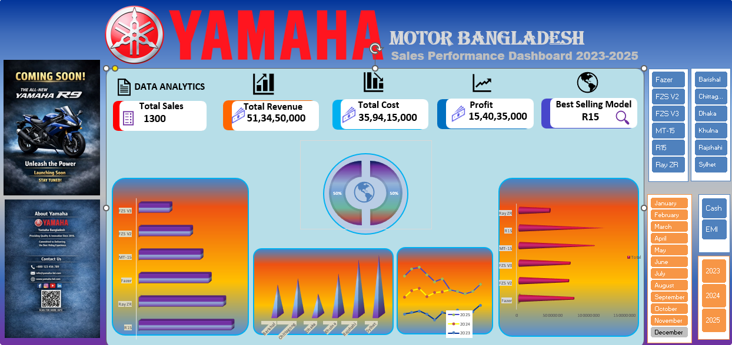
Sales & Business overview (dashboard 1)
Sales trend analysis : Sales trend analysis helps to understand how sales change over time. It shows monthly or yearly performance patterns. The trend indicates fluctuations in sales, with some months showing higher demand due to seasonal effects and promotional activities.
Payment Method : This analysis compares different payment methods such as cash and EMI. It helps understand customer payment behavior. The data shows that EMI is becoming increasingly popular, as it allows customers to purchase expensive bikes more easily.
Slicer Functionality : Slicers are used to make the dashboard interactive. They allow users to filter data based on categories such as bike model, division, and payment type. This makes the analysis more flexible and user-friendly.

Slide 10
customer insights (dashboard 2)
AGE Group Analysis : This section analyzes the age distribution of customers. It helps identify the target customer segment. The analysis shows that young customers dominate the motorcycle market, especially in the sports bike category.
Occupation analysis : This analysis shows the occupation of customers such as students, job holders, and business persons. It helps understand the economic background of buyers . The data indicates that students and young professionals are the primary customers.
Color Preference : This section highlights customer preferences regarding motorcycle colors .It is observed that darker and sporty colors are more popular among young riders.

Slide 11
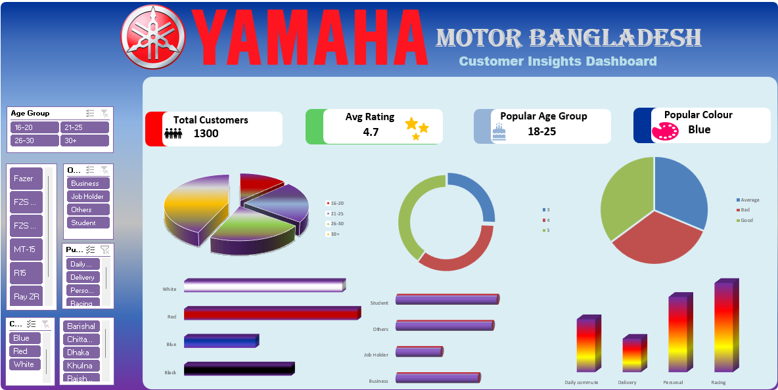
customer insights (dashboard 2)
Purchase Purpose : This analysis explains why customers purchase motorcycles, such as personal use, commuting, or business purposes .People usually purchase bicycles for getting around town and as a way to get from one place to another on a daily basis.
Customer Ratings : Customer ratings help measure satisfaction levels. Higher ratings indicate better customer experience and product satisfaction .The analysis shows that most customers give positive ratings, indicating good service quality.
Slicer Functionality : Slicers are used here to filter customer data dynamically. Users can easily analyze specific groups based on age, occupation, or preferences.

Slide 12
RECOMENDATION
Based on the analysis of Yamaha motorcycle sales and customer insights, several important recommendations can be made to improve business performance and customer satisfaction.
Firstly, the company should focus more on the youth market. The analysis shows that most customers belong to the young age group, especially students and young professionals. Therefore, Yamaha should design more marketing campaigns targeting this segment through social media, online advertising, and campus-based promotions. Secondly, popular models such as Yamaha R15, FZS series, and MT-15 should be given more priority in production and marketing. These models show higher demand compared to others, indicating strong customer preference for sporty and stylish bikes. Thirdly, the company should expand EMI facilities and make installment payment options more flexible. Many customers prefer EMI due to affordability issues, especially students and middle-income groups. Easier EMI options can increase overall sales.
What customers like in terms of color is also important. Some colors are really popular with buyers. So, Yamaha should think about making more bikes in the colors that people want. This could help them sell more bikes and attract new customers.
Finally, data-driven decision-making should be encouraged within the company. By continuously analyzing sales and customer data, Yamaha can better understand market trends and adjust their business strategies accordingly.

Slide 13
CONCLUSION
This project is all about looking at how well Yamaha motorcycles are selling and what customers like. We used Microsoft Excel to make it happen. The main goal was to see how the business is doing and what customers prefer by using pictures and graphs to show the data.
The second dashboard was all about getting to know our customers better. It showed us things like how old they are, what they do for work, what colors they like, why they buy from us, how happy they are with our products, and how they feel about the service they get. All this information helped us understand what makes our Yamaha customers tick and what they like.
When you look at the big picture, it's easy to see that younger buyers are really driving the market for motorcycles. They especially love the sporty models like the Yamaha R15, FZS, and MT series. Being able to pay in installments and getting good service also makes a big difference - it keeps customers happy and helps sales go up.
The use of Excel tools such as Pivot Tables, Pivot Charts, Slicers, and KPI indicators made the analysis more effective and interactive. These tools helped transform raw data into meaningful insights.
So, what we can take away from this project is that using data to make decisions is really important for businesses today. It helps them sell more, understand what customers want, and make good choices for the future. By looking at data, companies can figure out what's working and what's not, and use that information to make smart decisions that will help them grow. This is a key part of being successful in business, and it's something that all companies should be doing.

Slide 14
REFERENCE
The following sources were used to complete this project:
Microsoft Corporation. (n.d.). Microsoft Excel Documentation. Retrieved from https://support.microsoft.com/excel
Microsoft Corporation. (n.d.). Create a PivotTable to analyze worksheet data. Retrieved from https://support.microsoft.com
Microsoft Corporation. (n.d.). Create a PivotChart. Retrieved from https://support.microsoft.com
YouTube Tutorials: Various Excel dashboard and data analysis tutorials were followed to understand practical implementation techniques.
Course Materials / Class Notes: Lecture materials and instructions provided by the course instructor were used as a primary guideline for this project.
OpenAI. (2026). : (AI Tool). This tool was used to assist in structuring the report, improving language, and generating explanations.
Self-generated Dataset: The dataset used in this project was manually created and organized for academic purposes.
Note: AI tools were used only for assistance in writing and structuring the report. All data analysis, dashboard creation, and interpretations were done independently.

Slide 15
THANK YOU

